Slide 1
A DAY IN THE LIFE
OF A
CONTRACT PACKAGER
Notes:
In a contract packagers day there can be up to 20 individual customers’ brands being bottled and packaged at one site – some with their own customer supplied dry goods and some where the packager has sourced the dry goods.
When a contract packagers supplies the dry goods – cartons, dividers, glass, closure- we stand by the product and should there be any issues we get on and fix it and deal with our suppler separately.
.
.

Slide 2
2015 RECORDED NON CONFORMANCES
Notes:
I’d like to begin by showing the fault logs captured in 2015 and compare it to 2016.
Glass 55%
Labels 21%
Cartons 19%
Caps 5%
Wires .005%
Cork .002%

Slide 3
2016 RECORDED NON CONFORMANCES
Notes:
2016 saw:
A slight decline in glass faults to 44.8%
Slight increase in label issues 23.7%
Slight decrease in cartons 17.2%
Big increase in Capsule problems 135% increase to 11.7% , and a
250% jump in cork issues to 2.5% which we believe is due to the increase of exports to China who prefer cork closures
This information was presented at our Forums and helped drive actions and case studies/trials for glass and label application. These will be presented by Paul Grafton, Vinpac International’s Group QA Manager over the course of this afternoon.

Slide 4
2017 RECORDED NON CONFORMANCES
2017 saw a decrease in non conformances including a dramatic drop in non-conformances related to glass. This is mainly due to a drop in contamination events such as wet pallets and mould.
Label issues have fallen from 178 to 103 from 2016 to 2017. The bulk of the label issues are around manufacturing faults but design concerns are still being raised, so we still have a little way to go with communicating our capabilities to the wider industry. (Main issue with design is size/bottle compatibility and a lack of varnish free areas on neck labels).
Cartons have only had an increase in issues by 5 NCRs. Cap issues have increased, this has mainly been driven by an increase in high torque issues, but slightly counteracted by a decrease in thread forming issues.
Notes:
2017 saw a decrease in non conformances including a dramatic drop in non-conformances related to glass. This is mainly due to a drop in contamination events such as wet pallets and mould.
Label issues have fallen from 178 to 103 from 2016 to 2017. The bulk of the label issues are around manufacturing faults but design concerns are still being raised, so we still have a little way to go with communicating our capabilities to the wider industry. (Main issue with design is size/bottle compatibility and a lack of varnish free areas on neck labels).
Cartons have only had an increase in issues by 5 NCRs. Cap issues have increased, this has mainly been driven by an increase in high torque issues, but slightly counteracted by a decrease in thread forming issues.
All of us have the same customer, the owner of the wine brand. It is our collective responsibility (designers, printers, paper suppliers and packagers) to ensure the product is delivered to the consumer looking just like the customer expects.
Our objective is always to deliver the customer’s complete expectations in packaging quality and presentation.
To that end we all need to understand the limitations of the products and processes we control, and how these affect other links in the supply chain.
Our Forum today continues to reflect our ongoing efforts to improve this process.

Slide 5
Notes:
Here are some examples of non conformances
Winging neck labels

Slide 6
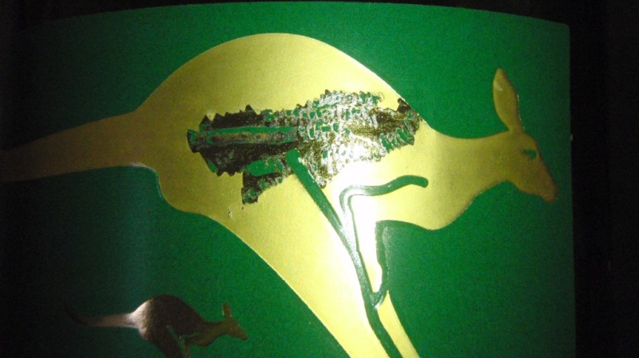
Notes:
Scuffing

Slide 7
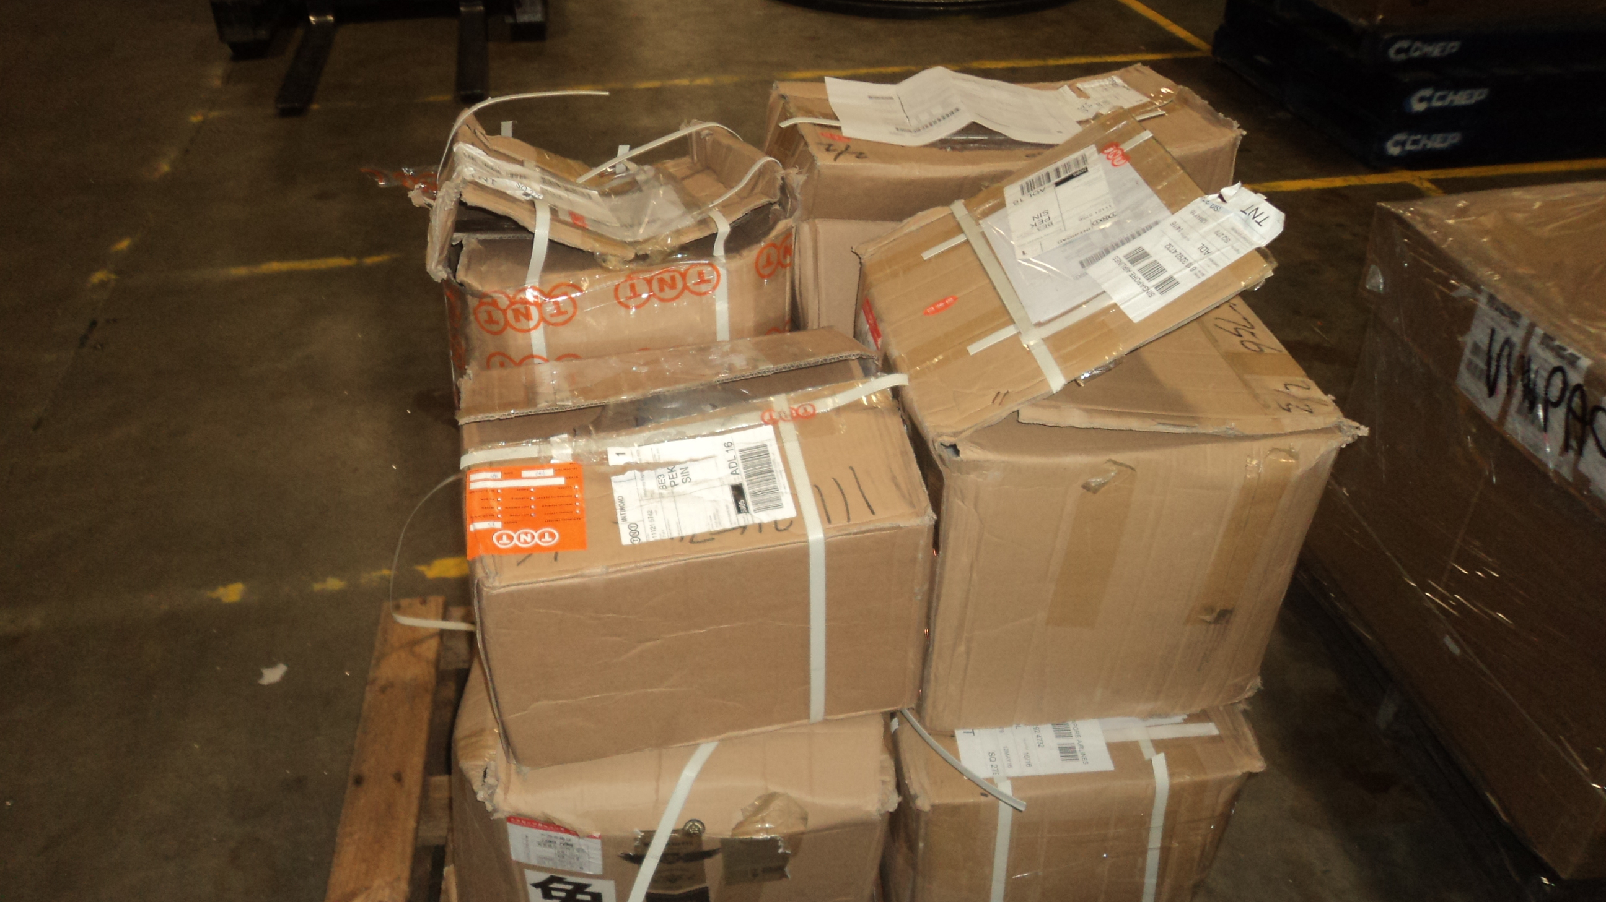
Notes:
Labels being delivered from an overseas customer’s printer

Slide 8
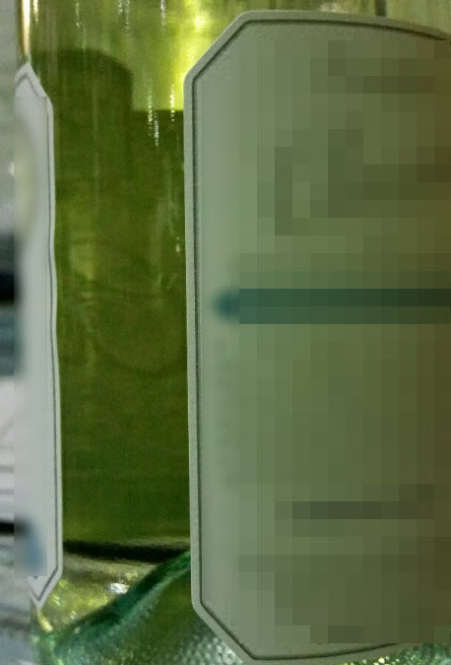
LABEL ISSUE
Front label outside WPA guidelines
No issues during production - First off inspection saw no issues - lifting after production
Approx. 17% fail rate 2 production days, 3 shifts
Notes:
Front label outside WPA guidelines
No issues during production - First off inspection saw no issues - lifting after production
Approx. 17% fail rate 2 production days, 3 shifts

Slide 9
Notes:
FOREIGN OBJECTS
Several of our members received customer l complaints about finding a white plastic foreign object in their wine. Unfortunately it is implied that foreign object contamination always happen during the bottling process.

Slide 10
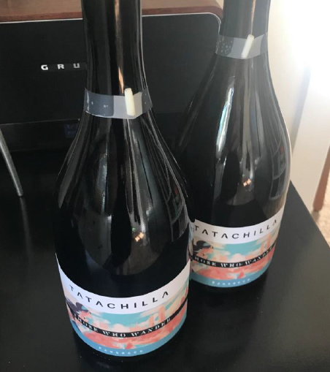
Notes:
You can see the similarity of the object found especially that angled cut and the tiered top.
When we collated the information it was across NSW Mildura and SA member sites.
Each site could not identify this piece of plastic as coming from their equipment.
Ultimate the culprit was
- next slide

Slide 11
The culprit – sparkling stopper style with 4 plastic legs inside silicon seal
Notes:
Sparkling stopper style with 4 plastic legs inside silicon seal. We can only surmise
After time the silicon seal degrades and the white legs fall into the bottle of wine
Faulty batch of stopper

Slide 12
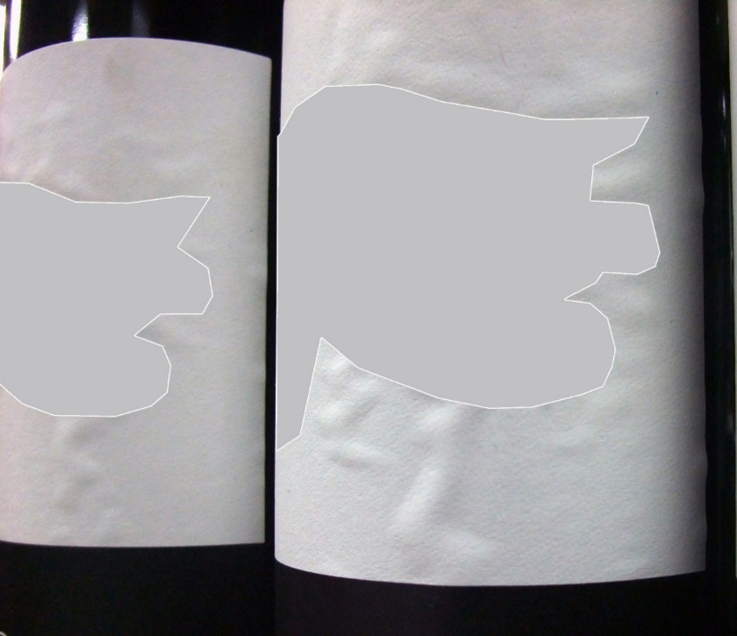
LABEL BUBBLING CASE STUDY
In January 2012 a customer found labelled stock with issues of lifting and bubbling
Product bottled July/August 2011
Photo of bubbling seen on the labels in storage
Notes:
> We’ve used an actual QA investigation undertaken by Vinpac International’s QA and Product Development team on bubbling and lifting labels as a case study for this presentation.
In January 2012 our customer found an issue with the front label on finished stock - lifting, bubbling/blistering.
We had bottled 4 skus using the same label size, paperstock and adhesive, so a cross section of all 4 was inspected at their warehouse and we found occurrences across all of them.
Samples of identified issues were taken back to our facility for further testing.
The QA data collected for these runs was checked for issues – with no anomalies found.

Slide 13
LET’S LOOK AT THE CIRCUMSTANCES IN 2012
The 4 SKUs were bottled on different dates on 2 different lines
The lifting/bubbling was similar across all 4 SKUs
All finished stock was held in customer warehouse
Two different printers produced the labels for the 4 SKUs
Notes:
Let’s look at the circumstances
The 4 SKU’s were bottled on different dates on different bottling lines and all exhibited similar lifting and bubbling.
This shifted our thoughts away from an application issue as we were seeing the identical failure across all stock of the 4 SKU’s in question
Cool conditions – Finished goods were being stored in a 3rd party warehouse without climate control
2 different printers were used to produce the labels using the same face stock and adhesive combination
Note: Whilst the same facestock is used by both printers, there are some differences in the capabilities of both.
One printer has extra stations on their print press which provides the ability to apply extra processes and/or embellishments, SUCH AS AN ADDITIONAL LAYER OF VARNISH

Slide 14
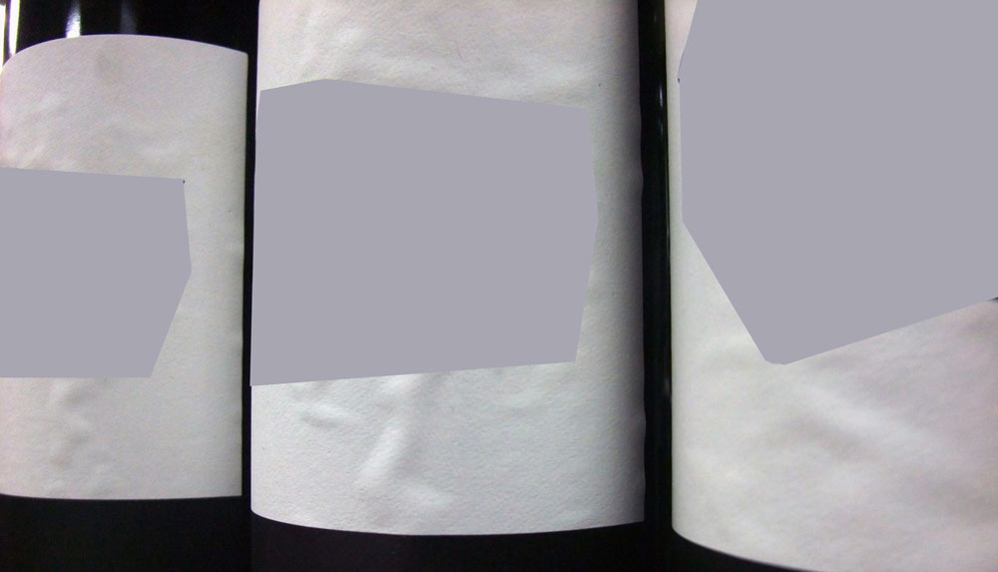
LABEL TRIALS
Trials included:
Two Printers
Two Face stocks
Label coatings:
Extra Coating
Standard Coating
Control Label
Three tests were performed
Notes:
We approached the printers and paper suppliers and asked them to undertake trials and PROVIDE FEEDBACK, using their knowledge and expertise of the print and paper/adhesive processes.
The paper manufacturers came on board and investigations/testing concluded that the paperstock and adhesive were all within specification, but allowed moisture penetration appeared to be the cause of the lifting/bubbling.
Based on this outcome, the printers decided to conduct further tests – in total 7 trial labels were produced at two different printer sites
All labels were then applied online and tested to identify the most robust option.

Slide 15
TEST 1: STEAM TEST
Sample bottles were taken from the line and left to stand for 24 hours – then held over steam for 30 seconds
RESULTS
Bubbling occurred around the embossed logo on all labels
Labels with extra coating showed less bubbling or no signs of bubbling
Control label displayed minimum bubbling
Notes:
<
For the Vinpac Steam test, bottles are held over steam for 30 seconds and observed for moisture ingress.
Result: The steam sells the exposed paper fibres and causes bubbling.
With these labels the results were:
Bubbling occurred around the embossed logo on all labels
Labels with extra coating showed less bubbling or no signs of bubbling
Control label displayed minimum bubbling

Slide 16
TEST 2: CONDENSATION TEST
Sample bottles were taken from the line and left to stand for 24 hours
Bottles then refrigerated for 24 hours, removed and then placed high humidity conditions
RESULTS
All bubbling that occurred was around the embossed logo and bottle seam
Labels with extra coating showed less bubbling, or no signs of bubbling
Control label displayed minimum bubbling
Notes:
Test performed 24hrs post application.
Bottles were then placed into fridge for 24 hours, removed and then placed into high humidity conditions using the printers’ standard condensation test
The labels with extra coating showed less bubbling or no signs of bubbling.
Other variants displayed bubbling around the embossed logo and bottle seam.
The “control” label displayed minimal bubbling.

Slide 17
TEST 3: CONDENSATION TEST
Sample bottles were taken from the line and left to stand for 48 hours
Bottles then refrigerated for 24 hours, removed and then placed high humidity conditions
RESULTS
Labels with standard coating showed very slight bubbling
Labels with extra coating showed no bubbling
2nd face stock showed a slight bubble
Control label showed slight bubbling
Notes:
Sample bottles were taken from the line and left to stand for 48 hours
The reason for 2 condensation tests was to verify that labels performance was similar after additional adhesion time
Trial labels with standard coating showed very slight bubbling
Trials with extra coating showed no bubbling
Control label with standard coating showed slight bubbling

Slide 18
OUTCOMES
Best performing face stock selected for next vintage
Label successfully applied for the following 4 years
Notes:
Based on the trial results the best performing stock/varnish/ink combination was selected - this stock used on next print run in agreeance with all parties.
Issues not seen on next production run.
Customer happy with outcome.
Random checks of product in warehouse within 3 weeks of bottling showed no signs of lifting or bubbling.
Overall a total of 44 manhours and 120 line minutes were taken by Vinpac staff to help resolve this issue

Slide 19
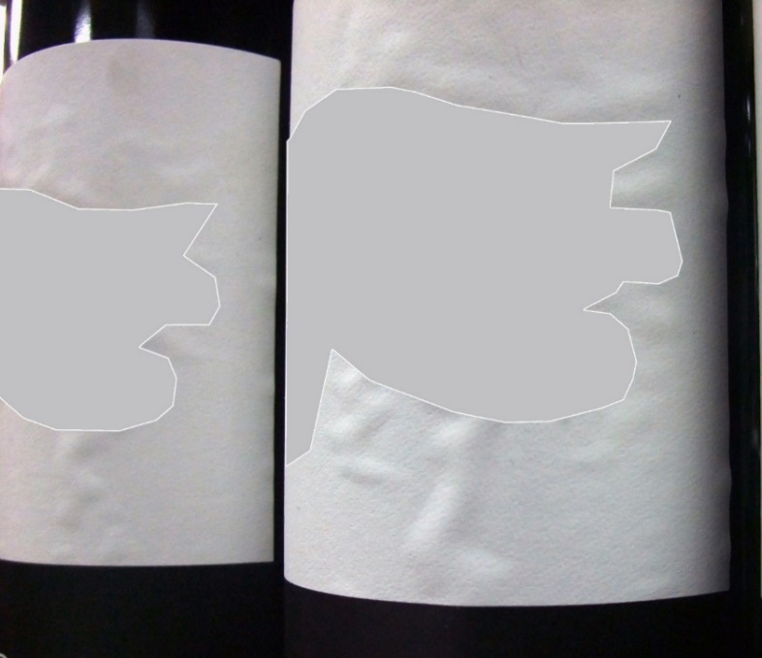
FAST FORWARD TO 2016 – BACK TO THE FUTURE!
August 2016 - same customer identified slight label edge lift and bubbling from the production runs June & July 2016 across 4 SKUs
Investigation commences
Notes:
same customer identified slight label edge lift and bubbling from the production runs June & July 2016 across 4 SKUs

Slide 20
LET’S LOOK AT THE CIRCUMSTANCES
All finished stock was held in a 3rd party warehouse
The lifting and bubbling was similar across all 4 SKUs
The 4 SKUs were bottled on different dates on 2 different lines which rules out application error
Notes:
All finished stock was held in 3rd party customer warehouse post bottling
Temperature estimate of 8-10 degrees inside.
We had bottled 4 SKUs so a cross section of all 4 was inspected at 3rd party warehouse and we found occurrences across all of them.
In our opinion this rules out an application issue as we were seeing the similar failure across all stock of the 4 SKU’s
Samples were taken back to Vinpac for testing.
Production data from these runs was reviewed and no anomalies found.
In gathering our information it was then we noticed that a different printer had produced them using a different paperstock and adhesive combination.

Slide 21
LABEL TRIAL 2016 – DRY AND WARM ENVIRONMENT
Label lifting barely perceivable
Notes:
As part of the investigation we conducted some application trails and you can see here is an example of “Dry Labels” 3 weeks after application
Note the label has already started lifting slightly.

Slide 22
LABEL TRIAL 2016 – STEAM TEST
Label hand applied to bottles and left to stand for 24 hours then held over steam for 30 seconds
RESULTS
Bubbling occurred around the edges of the label
Notes:
We again used the steam test to evaluate moisture penetration.
Steam stress tests were carried out on all labelled bottles.
The test method involved holding bottles directly over boiling water and stressing the label to steam for 30 seconds.
Here we can see how the steam has swelled the paper fibres and lifted the edges of the label.

Slide 23
LABEL TRIAL 2016 – CONDENSATION TEST
Labels hand applied and left to stand for 24 hours
Bottles refrigerated for 24 hours and removed
RESULTS
Bubbling occurred around the edges of the label
Notes:
Here is the “Refrigerated Labels” test results.
This is the same bottle as the previous slide
Edge lifting is accentuated from being in the fridge.

Slide 24
PLATE GLASS APPLICATION TEST
We hand applied labels to plate glass to compare variations in adhesive contact
Notes:
The Adhesive contact with the glass was investigated further.
To do this, we hand applied labels from both the 2015 and 2016 bottlings to assess and compare the differences and variations in adhesive contact.
This was done to compare the previous vintage that had not shown any issues.

Slide 25
PLATE GLASS APPLICATION RESULTS
2014 Vintage Bottled 2015
2014 Vintage Bottled 2016
Notes:
The plate glass test clearly shows the difference if the coverage of adhesive contact against the glass and we understand this is primarily due to the difference in liner – Glassine vs PET

Slide 26
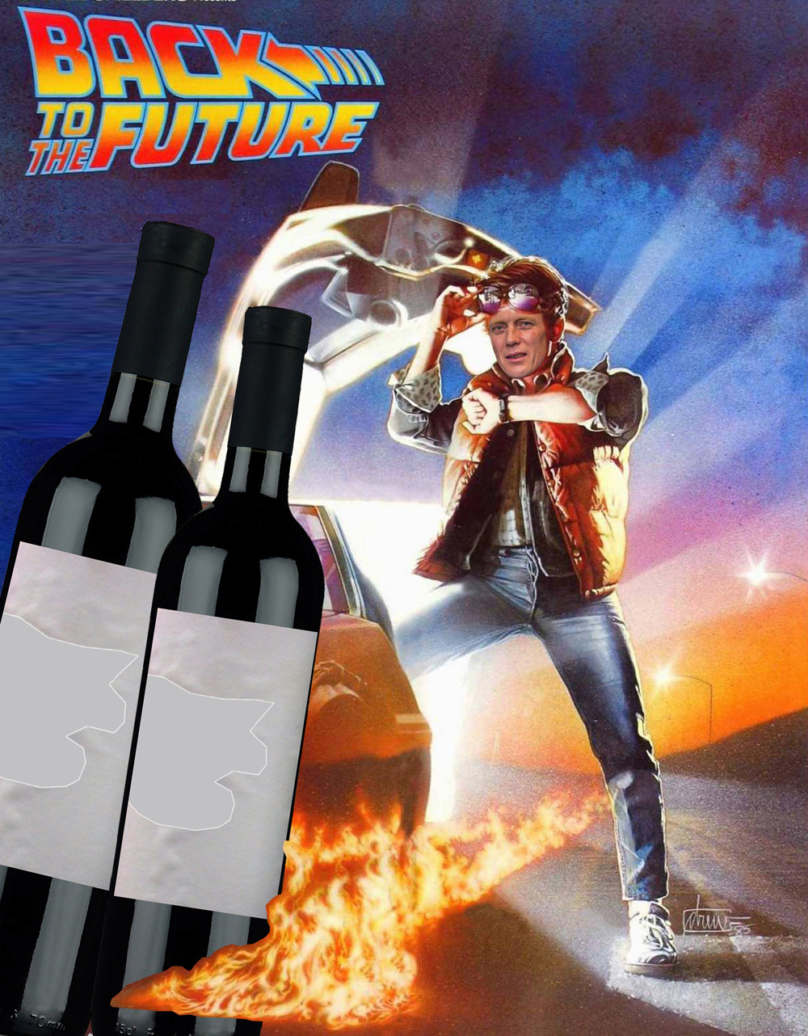
WHERE
ARE
WE
AT
NOW?
Notes:
During our label trial process we discovered that there was one point of difference between the bottling of 2015 and 2016 – there had been a change of label printer and face stock.
The customer, printer and Vinpac QA all attended the next bottling using the same labels.
The labeler application process and set up were observed and all present agreed that label finish quality was acceptable.
All labels assessed at the time of bottling were deemed to be free of lifting and bubbling.
Labelled samples were taken straight from the line and left for 24hrs in dry & warm conditions (office)
These samples were then placed into the refrigerator for 24hrs.
After 24hrs in the refrigerator lifting and bubbling were observed – results almost identical to initial trial results.
In closing, I chose this example to highlight how one change can have such a detrimental effect on label application.
As a contract packager we are the last link in the supply chain – and when the end result doesn’t meet the expectations of the customer it seems that application is the strong suspect.
Yes there can be other influences such as glass sink and bulge, cold end coating, label too big for the label panel.
But together we can use our different knowledge and expertise in our given fields to set benchmark tests and specifications that provide our customers and their designers with the tools and information they need to make the best decisions for their brands.

